Slide 1
Welcome to Psy 652 Lab! Module 9: Multiple Regression

Slide 2
Objectives
Description of dataset
Multiple Regression vs. Simple Linear Regression (SLR)
Regression output with explanations

Slide 3
Variable descriptions of today’s dataset (slp)
The data set includes the following predictor and outcome variables:
age: Participant age
anxiety: Participant’s level of general anxiety measured at the start of the study via a multi-item scale. The scale (average of all items) ranges from 1 to 7, where a higher score indicates a higher level of anxiety.
hygiene: Participant’s sleep hygiene at week 6. It ranges from 0 to 10, and higher means better sleep practices.
sleep: Participant’s average sleep efficiency during the month following the intervention, calculated as time spent in bed asleep (minus all the awakenings), divided by the total time spent in bed. It is expressed as a percentage.
lifesat: Participant’s sense of life satisfaction measured 30 days after the completion of the intervention. It is a multi-item scale that ranges from 1 to 7, where a higher score indicates more satisfaction.

Slide 4
Differences between Multiple Regression and Simple Linear Regression (SLR)
There isn’t much!
What changes our interpretation of the coefficients (slopes).
Your R² and significance tests are interpreted the same!
The only difference is that, now, we have to indicate that we are controlling for other variables in the model

Slide 5
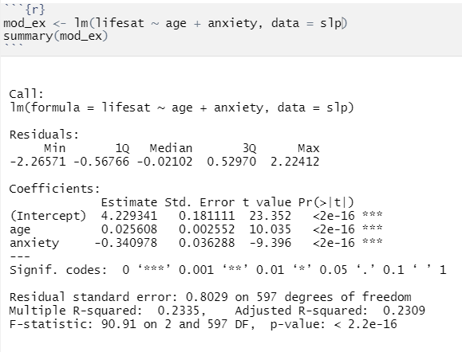
Example regression results and interpretation (Outcome = Life satisfaction)

Slide 6
Example regression results and interpretation (Outcome = Life satisfaction)
(Intercept) = The expected life satisfaction score of someone at age 0 and an anxiety level of 0
age = For every one-unit increase in age, there is an expected .026 increase in life satisfaction WHILE CONTROLLING FOR ANXIETY.
anxiety = For every one-unit increase in anxiety level, there is an expected .034 decrease in life satisfaction WHILE CONTROLLING FOR AGE.
All coefficients are significant
Overall model is significant
Our model explains 23.35% of the variance in Life Satisfaction

Slide 7
What is happening?
* Not drawn to scale
Variance in anxiety
Variance in Life Satisfaction
Variance in age

Slide 8
What is happening?: R²
* Not drawn to scale
Variance in anxiety
Variance in Life Satisfaction
R²
Variance in age
R² = The proportion of variance explained by the whole model (Even if it’s shared)

Slide 9
What is happening?: Coefficients
* Not drawn to scale
Estimate for anxiety
Variance in anxiety
Variance in Life Satisfaction
Variance in age
Shared variance is removed
Estimate for age
Your coefficients are what is uniquely being explained by the predictor alone (excluding any shared variance).

Slide 10
Using the model to make predictions
What is the expected life satisfaction of an individual that is age 52 and has an anxiety level of 5?
It’s simple Algebra!
Y_{Lifesat} = β₀ + β_{age} + β_{anxiety}
Lifesat = Intercept + (.026 *Age) + (-.341*anxiety)
Lifesat = 4.23 + (.026*52) +(-.341*5)
Lifesat = 3.877
The expected life satisfaction of an individual that is age 52 and has an anxiety level of 5 is 3.877!

Slide 11
Let’s code!

